Slide 1


Session 2

Slide 2


Session 2
Introduction
Reminder of housekeeping and our group rules/manners
Miss the hook – avoiding the conflict
Managing own feelings
Home tasks

Slide 3

Fisherman … casting out the hook

Slide 4

Who is the fish and what is the hook ?

Slide 5

Hooking you in …

Slide 6
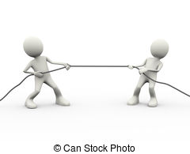
Tug of war

Slide 7
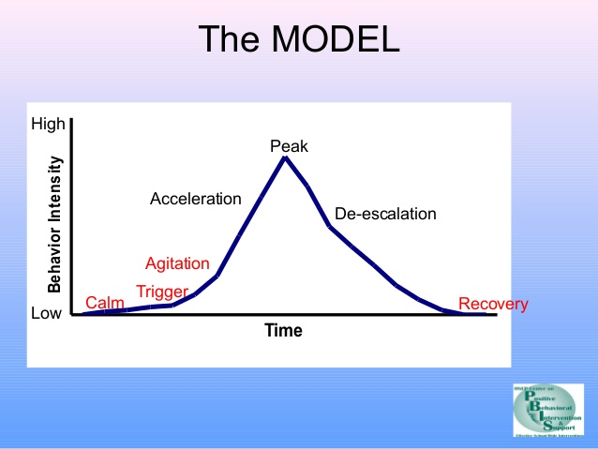
Escalation Curve

Slide 8
Personal Statement
I feel (name that feeling)
When (say what happened)
Because (why it upsets you)
I would like (what you want to happen or change)

