Slide 1


Session 9

Slide 2


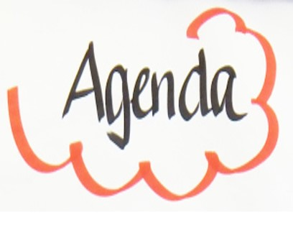
Session 9- The others
Introduction
Reminder of housekeeping and our group rules/manners
Keeping a young person as safe as possible
Protective factors
Parental roles
The Others
Home tasks

Slide 3
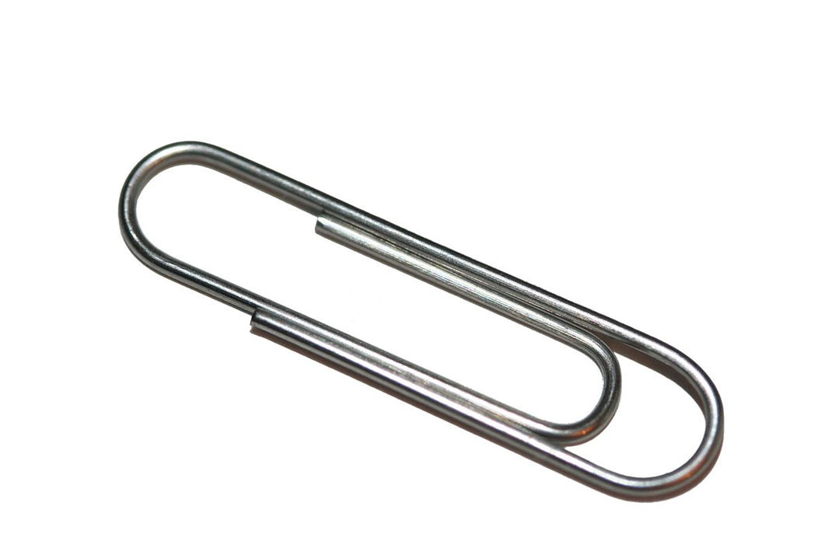
How many ways?

Slide 4
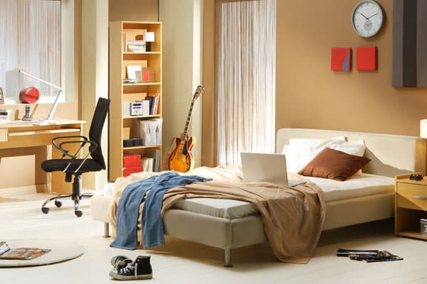
Any teenagers bedroom

Slide 5
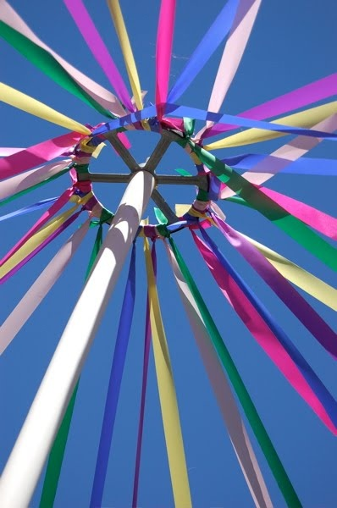
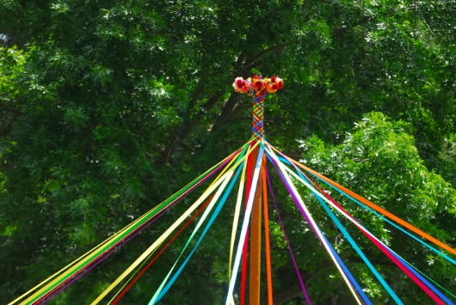
Maypole metaphor

Slide 6

Stone in the pond metaphor

