Slide 1


Session 8

Slide 2



Session 8
Introduction
Reminder of housekeeping and our group rules/manners
Managing the difficult times
Home tasks

Slide 3
Helicopter parent

Slide 4
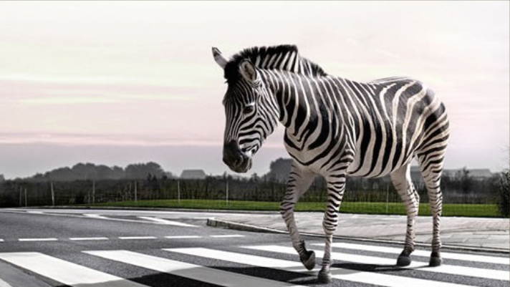
Zebra Crossing parent

Slide 5
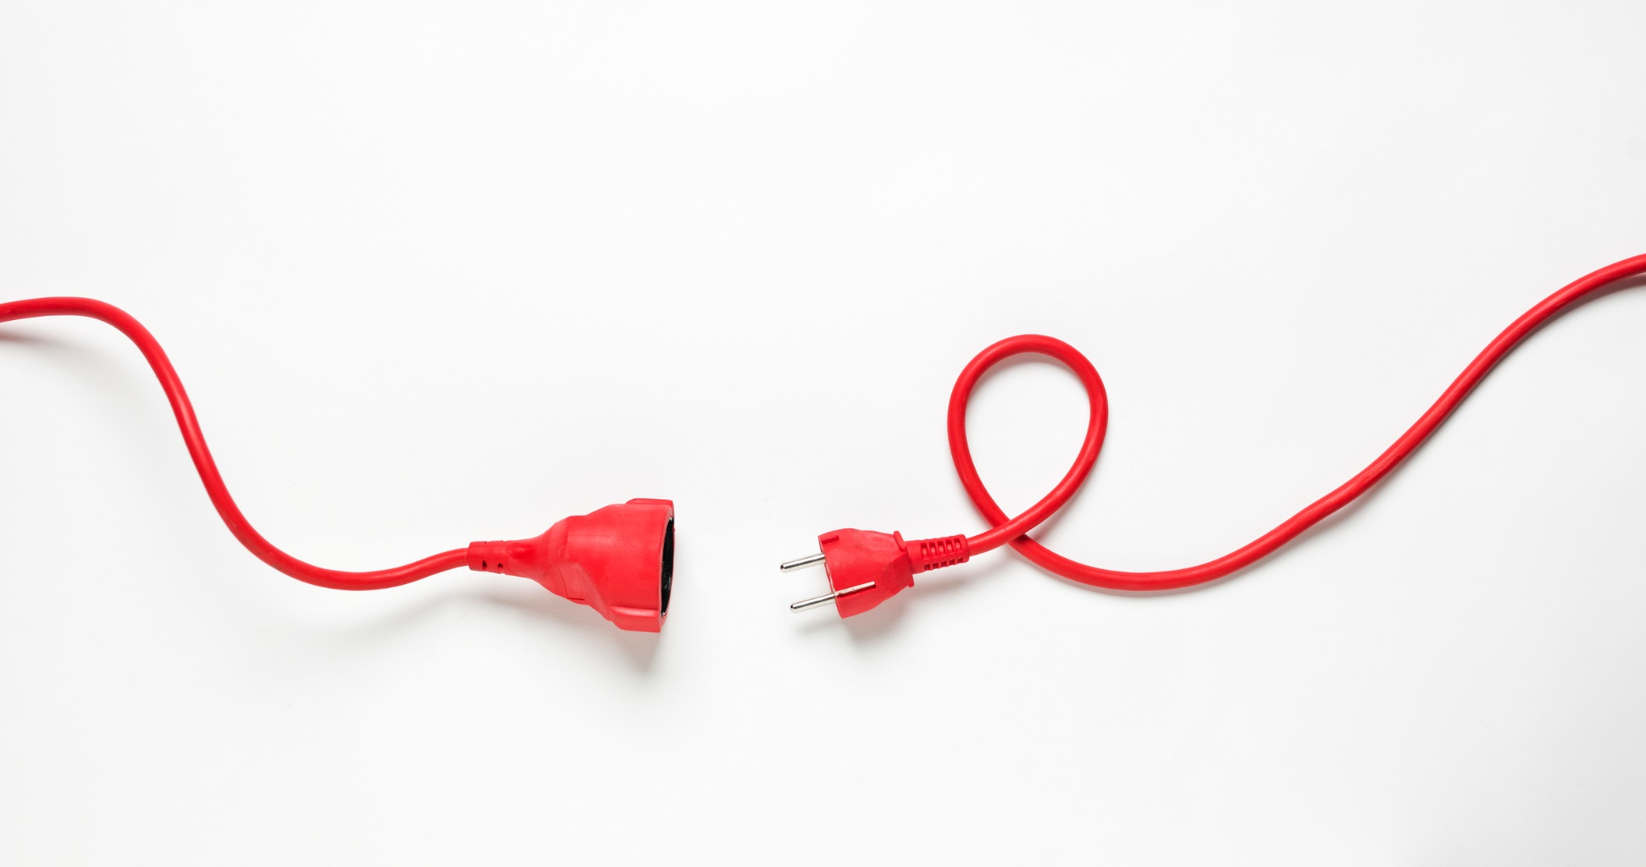
Un Plugged parent

Slide 6

Consultant Parent

Slide 7
I-Statement
I feel (name that feeling)
When (say what happened)
Because (why it upsets you)
I would like (what you want to happen or change)

Slide 8
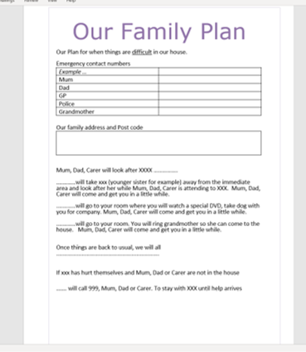
Family Plan example
Our Plan for when things are difficult in our house.
Emergency contact numbers
Family address and Post code …..
Mum, Dad, Carer will look after XXXX ...............
............will take xxx (younger sister for example) away from the immediate area and look after her while Mum, Dad, Carer is attending to XXX. Mum, Dad, Carer will come and get you in a little while.
............will go to your room where you will watch a special DVD, take dog with you for company. Mum, Dad, Carer will come and get you in a little while.
............will go to your room. You will ring grandmother so she can come to the house. Mum, Dad, Carer will come and get you in a little while.
Once things are back to usual, we will all ................................................................
If xxx has hurt themselves and Mum, Dad or Carer are not in the house
……. will call 999, Mum, Dad or Carer. To stay with XXX until help arrives

