Slide 1


Session 7

Slide 2


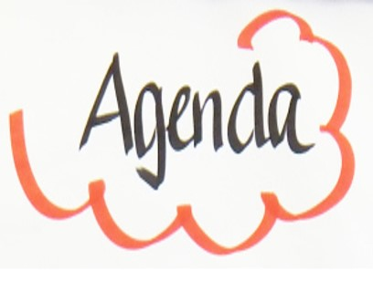
Session 7
Introduction
Reminder of housekeeping and our group rules/manners
Consequences
Home tasks

Slide 3

Rule 1. Ask yourself who has ownership of the problem

Slide 4
Rule 2. Own your own feelings- use ‘I’ statements

Slide 5
I-Statement
I feel (name that feeling)
When (say what happened)
Because (why it upsets you)
I would like (what you want to happen or change)

Slide 6
Rule 3 The consequence needs to have a direct and obvious link to the behaviour

Slide 7
Rule 4 Give consequences with sadness & empathy

Slide 8
Rule 5 Clean slate … move on

Slide 9
Natural or logical consequence ?
YP MISBEHAVES (NOT RELATED TO SELF HARM)
WHO OWNS THE PROBLEM ?
IS THERE A NATURAL CONSEQUENCE?
IS THERE A LOGICAL CONSEQUENCE?

Slide 10
There is a Natural consequence ?
GIVE AN I STATEMENT (PARENT IN CONTROL)
MANAGES OWN FEELINGS
WIPE THE SLATE CLEAN

Slide 11
Is there a logical consequence but…
PARENT FEARS YP WILL SELF HARM
NO LOGICAL CONSEQUENCE GIVEN
GIVE AN ‘I’ STATEMENT (PARENT IN CONTROL)
PARENT MANAGES OWN FEELINGS
WIPE THE SLATE CLEAN

Slide 12
Is there a logical consequence but…
PARENT DOES NOT FEAR YP WILL SELF HARM
WILL A LOGICAL CONSEQUENCE FEEL UNCOMFORTABLE FOR PARENT BUT SAFE
PUT IN A SHORT CONSEQUENCE.
GIVE WITH EMPATHY & SADNESS

Slide 13
A Logical consequence is given …
PARENT DOES NOT FEAR YP WILL SELF HARM
FOLLOWS THROUGH WITH CONSEQUENCE
WIPE THE SLATE CLEAN

Slide 14
Logical consequence given but…
PARENT DOES NOT FEAR YP WILL SELF HARM
FOLLOWS THROUGH WITH CONSEQUENCE
WIPE THE SLATE CLEAN

Slide 15
A Logical consequence given but…
PARENT FEARS YP WILL SELF HARM
WITHDRAW CONSEQUENCE
GIVE AN ‘I’ STATEMENT (PARENT IN CONTROL)
PARENT MANAGE OWN FEELINGS
WIPE THE SLATE CLEAN

