Slide 1


Session 2

Slide 2



Session 2
Introduction
Reminder of housekeeping and our group rules/manners
Teen development - Road to Independence
The brain explained
Home tasks

Slide 3
Road to Independence
Baby
Child
Adolescent
Adult

Slide 4

Teens need to
Build mature relationships with both sexes
Learn to be independent e.g. ironing, cooking, managing their own money
Finish school, take exams, make plans for the future
Feel ok with their body , how it is growing and those tricky hormones

Slide 5
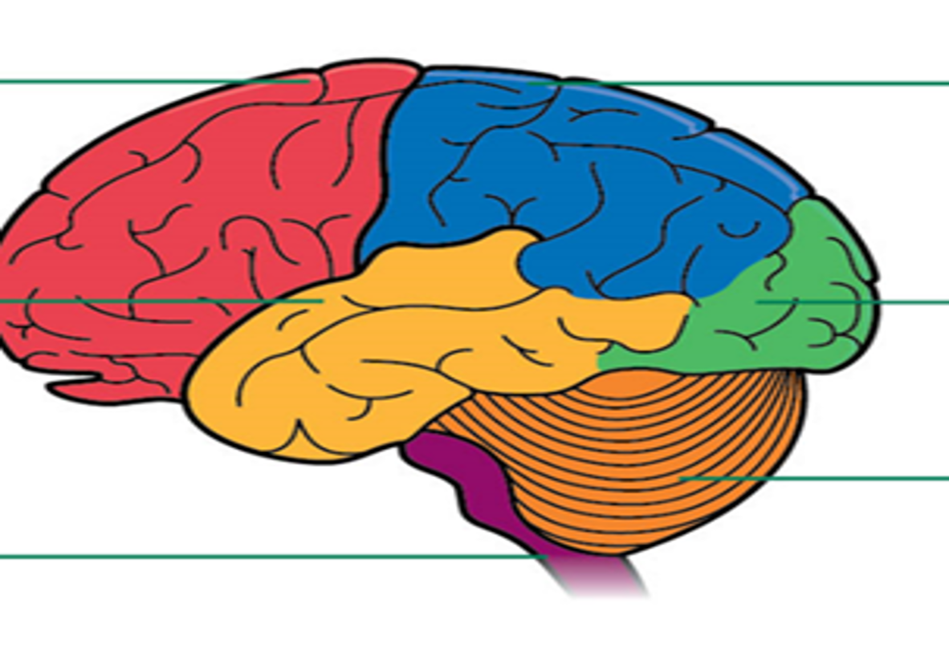

Slide 7
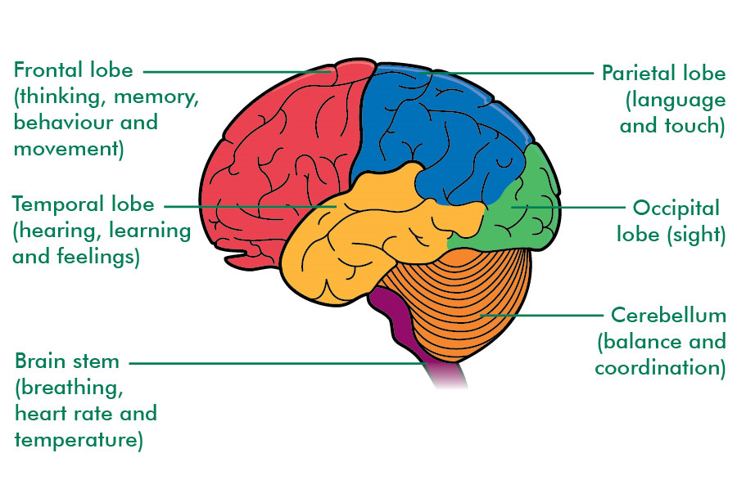
Brainstem

Slide 8
Brainstem
Breathing
Blood pressure
Heartbeat
Swallowing
Alertness & Sleep
Body temperature
Digestion

Slide 9
Brainstem

Slide 10
Brainstem
Cerebellum

Slide 11
Cerebellum
Balance
Co-ordination
Fine muscle control

Slide 12
Cerebellum
Brainstem

Slide 13
Occipital Lobes
Cerebellum
Brainstem

Slide 14
Occipital Lobe
Vision
&
Colour
Blindness

Slide 15
Occipital Lobes
Cerebellum
Brainstem

Slide 16
Parietal Lobe
Occipital Lobes
Cerebellum
Brainstem

Slide 17
Parietal Lobe
Understanding language
Behaviour
Memory
Hearing
Cognition
Comprehension

Slide 18
Parietal Lobes
Occipital Lobes
Cerebellum
Brainstem

Slide 19
Parietal Lobes
Temporal Lobes
Occipital Lobes
Cerebellum
Brainstem

Slide 20
Temporal Lobes
Left from right
Sensation
Reading
Understanding spatial awareness
Relationships

Slide 21
Parietal Lobes
Temporal Lobes
Occipital Lobes
Cerebellum
Brainstem

Slide 22
Frontal Lobes
Parietal Lobes
Temporal Lobes
Occipital Lobes
Cerebellum
Brainstem

Slide 23
Frontal Lobe
Thinking
Reasoning
Judgement & evaluation
Behaviour
Memory
Speaking
Movement

